Slide 1
Dog Dash
Present by Fazle Ryan Chowdhury, Rajendra Dhanraj, Manjula Guneratne, Malek Ben Jemia,
Richard Lim, Curtis Smith, Neeko Tang,
Johann Taylor, Shanshan(Tina) Xu

Slide 2
Dog Dash Explained
Even though more and more people are working from home and potentially have more time to take care of their dogs, the reality is that some people have a job function that does not allow them to go outside for a dog walk. Even when the dog owner has time, he/she may want to spend it on other activities than walking the dog. Elderly people could also need help walking their dog especially during cold weather.

Slide 3
The Process
Login
Owners post jobs
Selecting walkers to fulfill the jobs
Selected walkers to complete the jobs
Walkers apply jobs

Slide 4









Technologies

Slide 5
Work Breakdown
Front-End:
Fazle Ryan Chowdhury
Johann Taylor
Manjula Guneratne
Neeko Tang
Rajendra Dhanraj
Richard Lim
GitHub & Heroku:
Curtis Smith
Project Management:
Malek Ben Jemia
Neeko Tang
Back-end:
Curtis Smith
Malek Ben Jemia
Shanshan Tina Xu
Reademe & PPT:
Shanshan Tina Xu

Slide 6
Overview of Project 3
Success
- worked well as a team - agile methodology - daily scrums - well balanced skills
Challenges
- Merge conflicts - Timelines - scope screep - raising bugs and communicating

Slide 7
Future Plans
Adding online shopping for pet products
Implementing location system for near search and dog dating
Expanding service to all pets, like pet B&B
Adding security system to prevent dog stealing

Slide 8
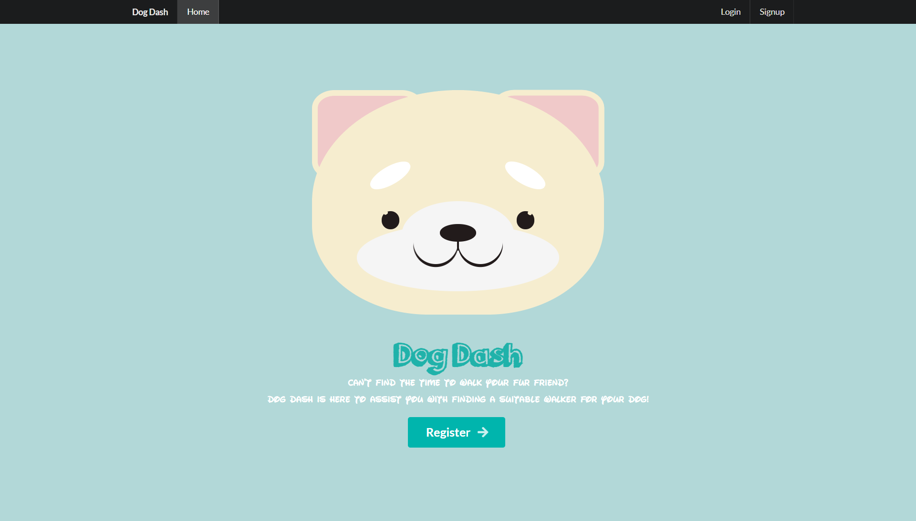
Demo

Slide 9
THANK YOU
On Behalf of Team 3
Deployed Website: https://dog-dash.herokuapp.com/
Github Repository: https://github.com/pro3gro3/walk-my-dog

